Slide 1
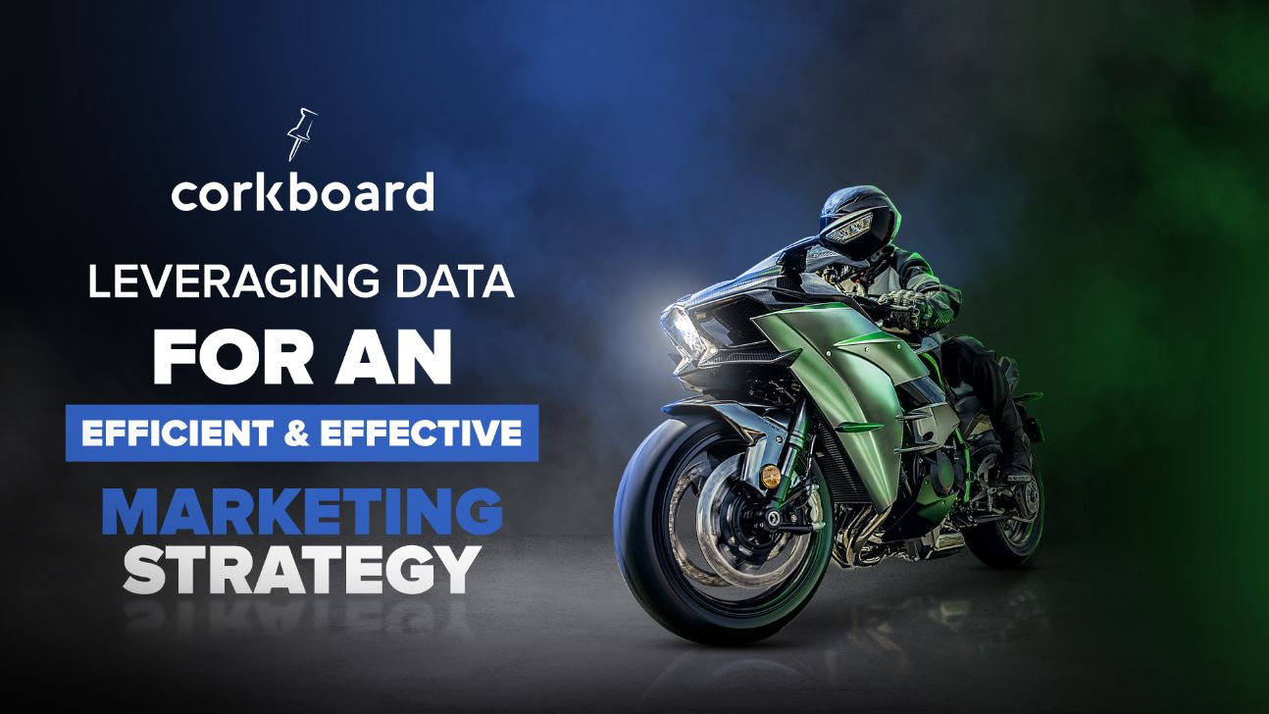

Slide 2

Who We Are
Corkboard Concepts is a strategic marketing agency providing data driven advertising campaigns through primarily digital mediums. Newer to market, Corkboard Concepts has seen fast pace growth in business, team and capabilities.
We are excited to bring efficient and high performing campaigns to our clients, and strive to exceed expectations of our clients.

Slide 3

Today’s Agenda
Leveraging Data
Assisting your group on getting a better handle of your individual dealerships data and scaling with your group relationship.
A Marketing Team, In Your Corner
An introduction to Corkboard Concepts services and how we can help you.

Slide 4

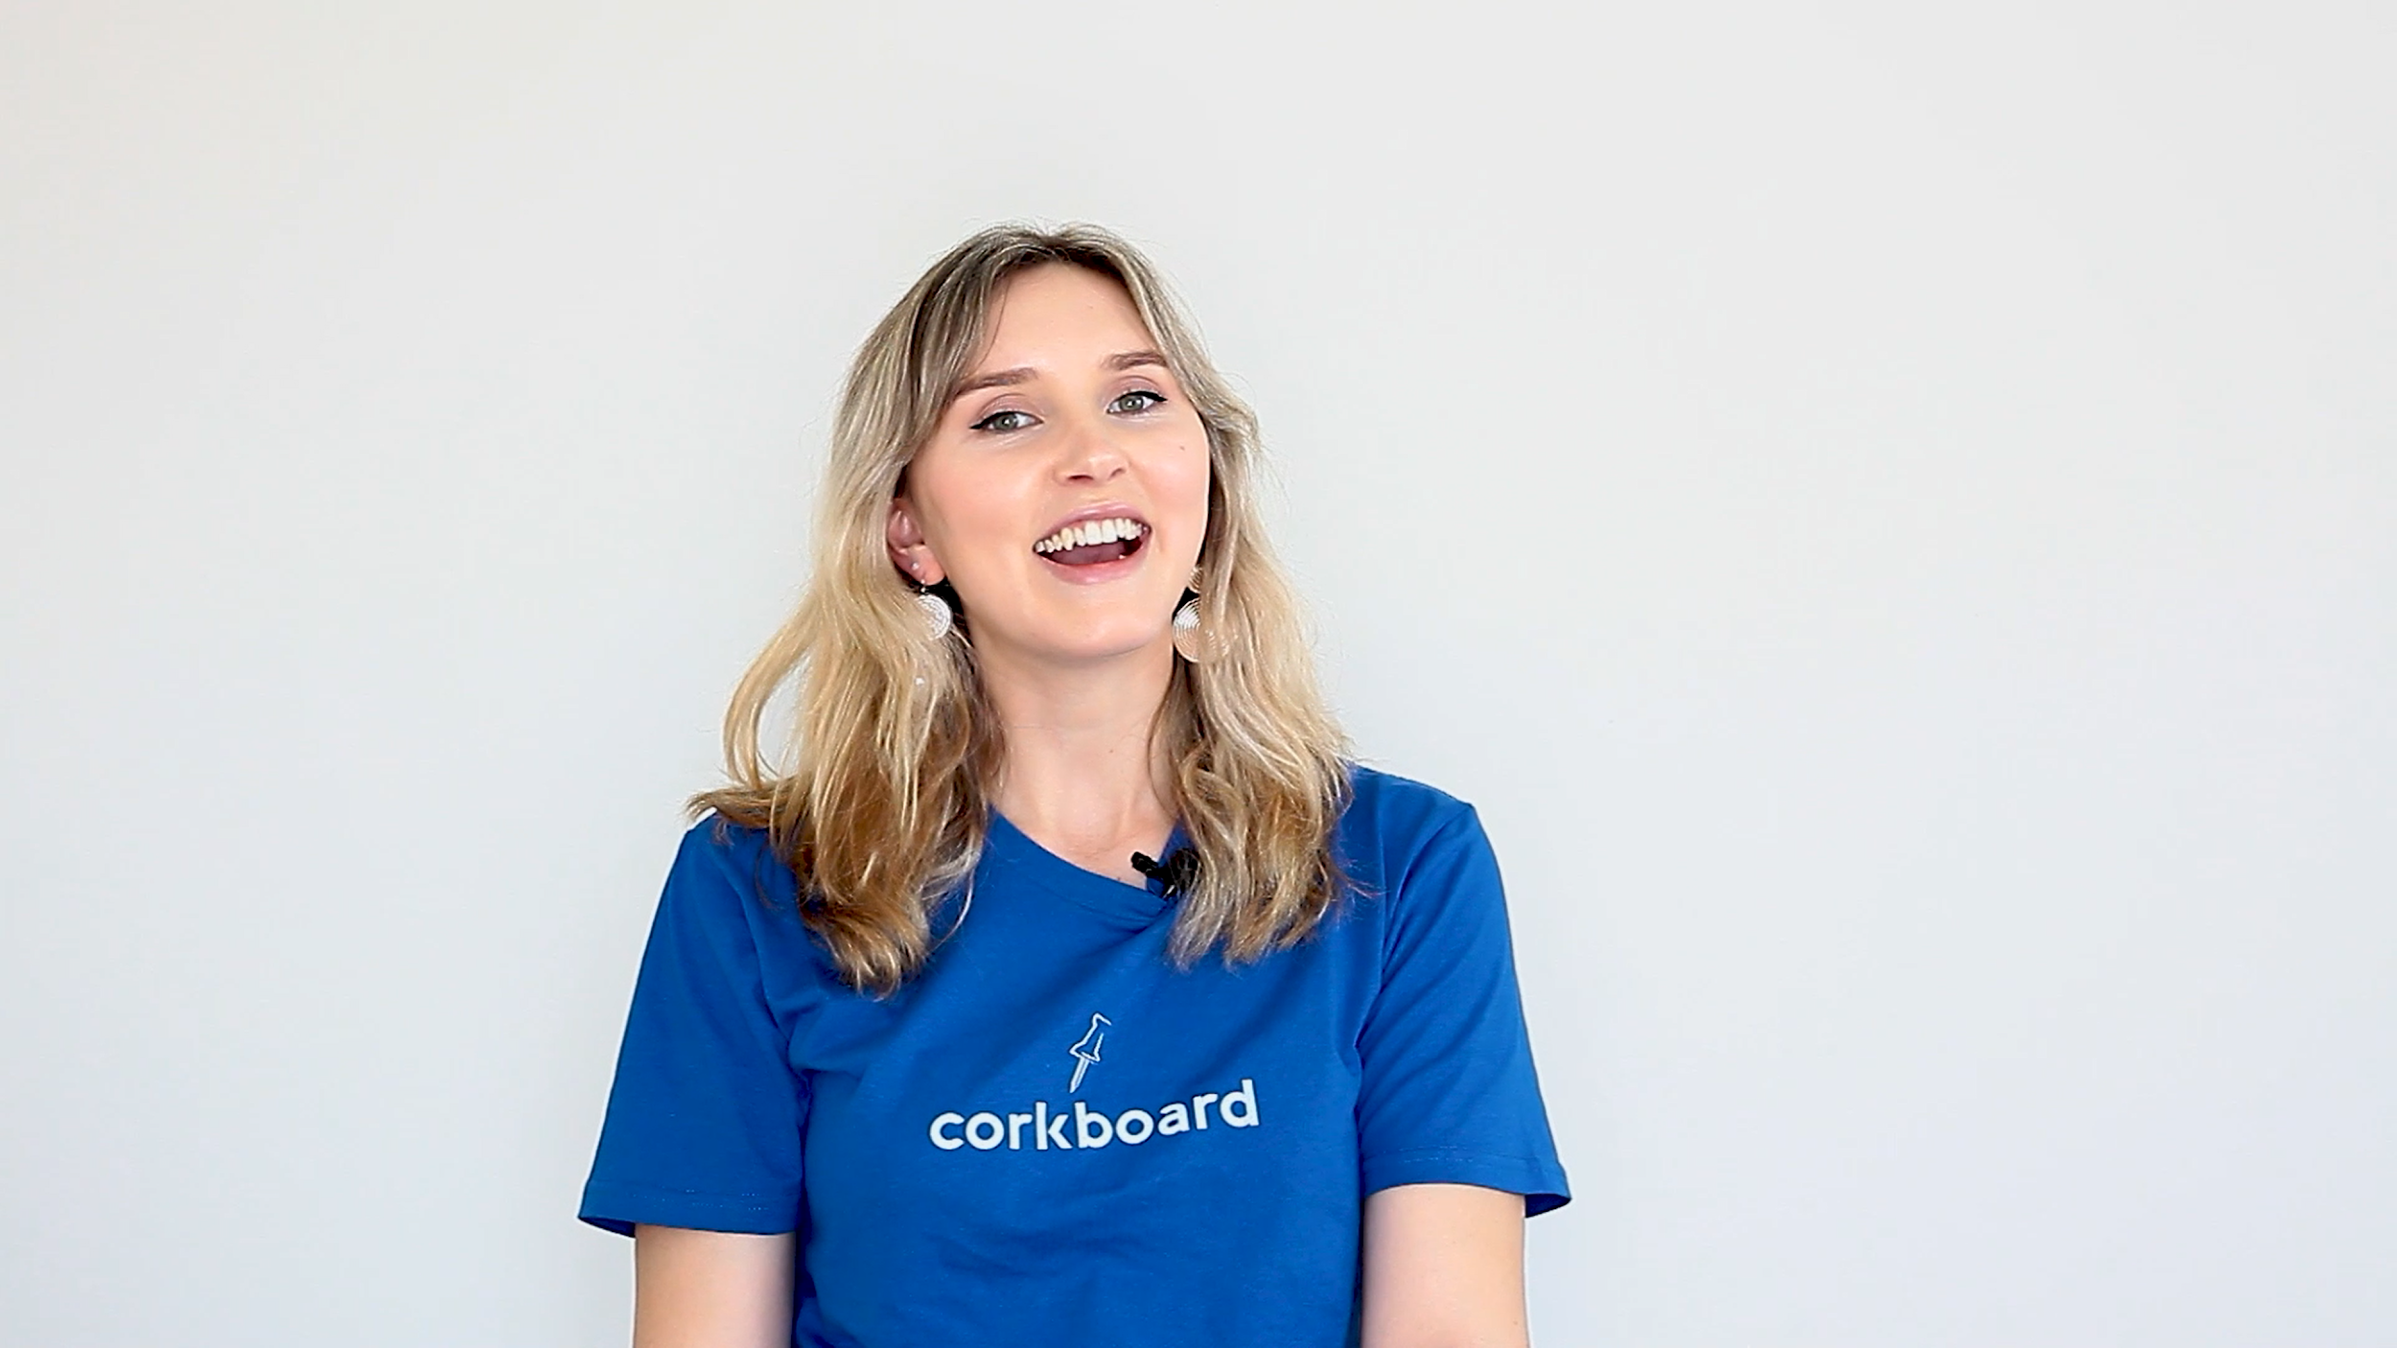

Audience Modelling: Audience Sets, At Scale
If you understood the behaviors of 100 people before buying a product from you, would that help your business? If you understood the behaviors of 1000 people before buying a particular brand/model, would that help your business?
3rd Party Audiences are being removed, making targeting more difficult on Facebook and other platforms.
1st Party Audiences can provide better targeting, constantly get refreshed and can be fully manipulated.

Slide 5




Corkboard Benefits
Data-Driven Solutions: Effective digital-conversion tracking, scalable audiences and data management.
Strong Industry Relationships: Google Partners, Facebook for Agencies, Multiple DSP Usage etc.
Dealer-First Approach: We are your marketing team, in your corner. We take your position first over all others, including advertising platforms & even manufacturers.

Slide 6
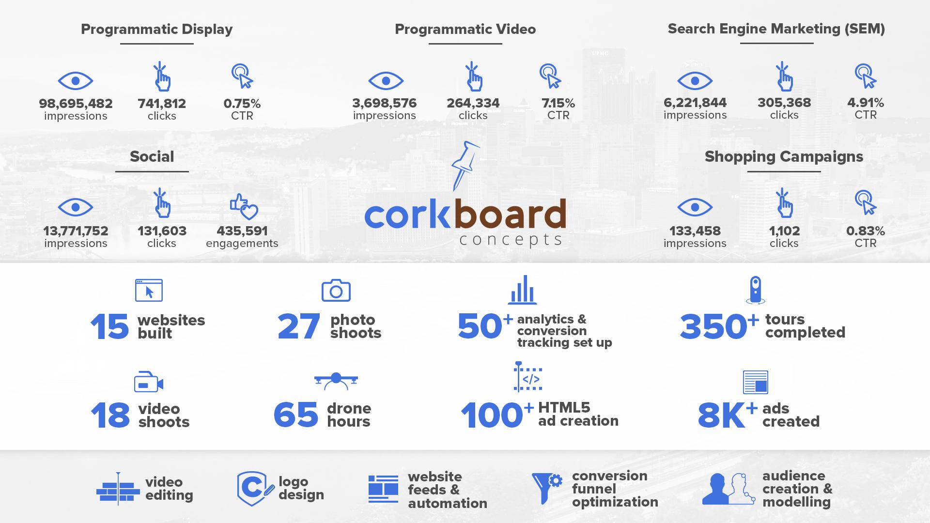

Slide 7
What We Do
Paid Advertising
Programmatic Advertising: Digital display, OTT, & pre/post roll ads served to targeted audiences
Search Engine Marketing (SEM / Paid Search): Keyword-driven ads on Google
Social Media Marketing: Targeted ads on Facebook, Instagram, and/or LinkedIn
Organic Management:
Search Engine Optimization (SEO): Ongoing work to increase visibility in search engines (Google)
Social Media Management: Managing your social media presence
Creative Services: Digital Design/Editing, Marketing Collateral, Drone photography/video, still photography/video, 360° virtual photography
Development and Website Maintenance: Designing, building, and maintaining websites, scripts, custom programs, and more.

Slide 8

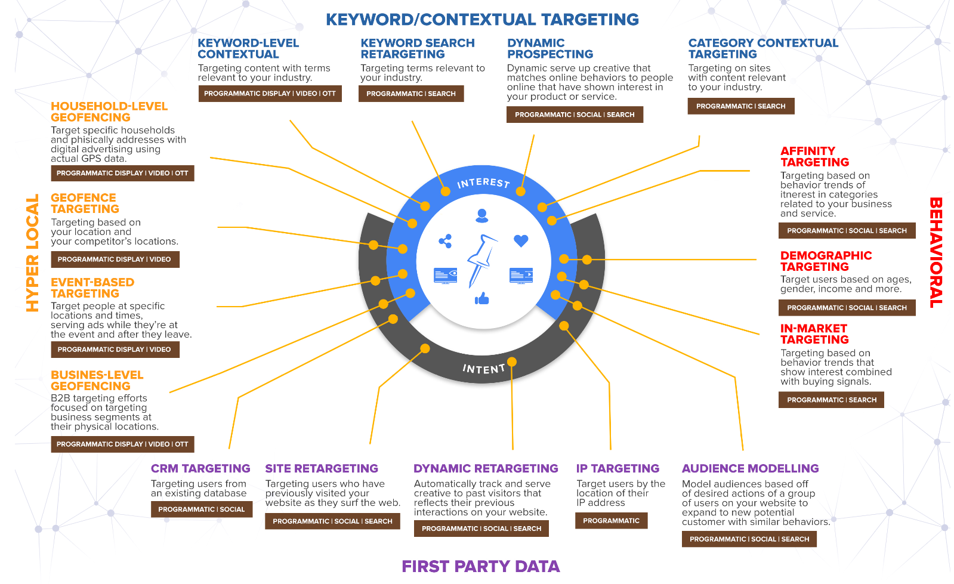
Staying Targeted:

Slide 9

Our Approach: Search Example
Three Types Of Search Queries:
Navigational
Informational
Transactional - this is where we focus search dollars
The Process:
Establish Goals (with client and on site)
Set up a highly organized campaign structure
Build out targeting, match with ads (3-5 ads per group)
Analyze and Continuous Optimization
Layer, Separate, Enhance, Negate Targeting
Continuously Updating Ads & Extensions
“Defending” Your Presence

Slide 10
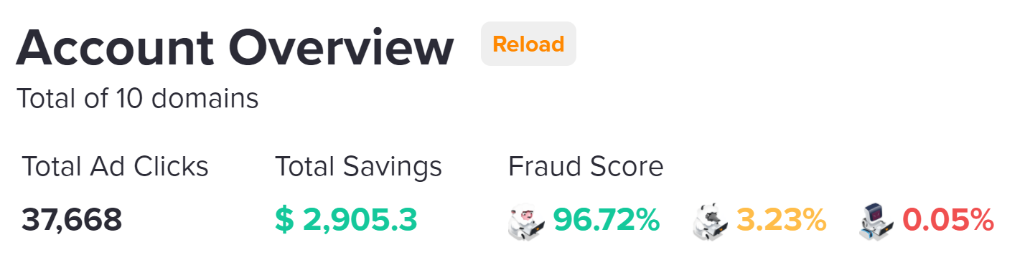
Change Tracker: 1 Year
Ad Fraud Prevention:

Slide 11

Pound for Pound Comparison
Product | Before Cost | Before Results | Now Cost | Now Results
Programmatic Display | $6,000 | 168,597 imp. 362 clicks | $6,000 | 841,000+ imp. 1,230 clicks
Programmatic Video | $1,094 | 23,404 imp. | $2,600 | 96,100+ imp.
Social Media | $1,094 | 84,302 imp. | $1,000 | 97,124 imp.
Search Engine Marketing | $7,311 | 12,680 imp. 1,288 clicks | $3,000 | 22,100 imp. 2,010 clicks
Comparison: Dealership using a preferred vendor vs. Corkboard Concepts marketing campaign.

Slide 12

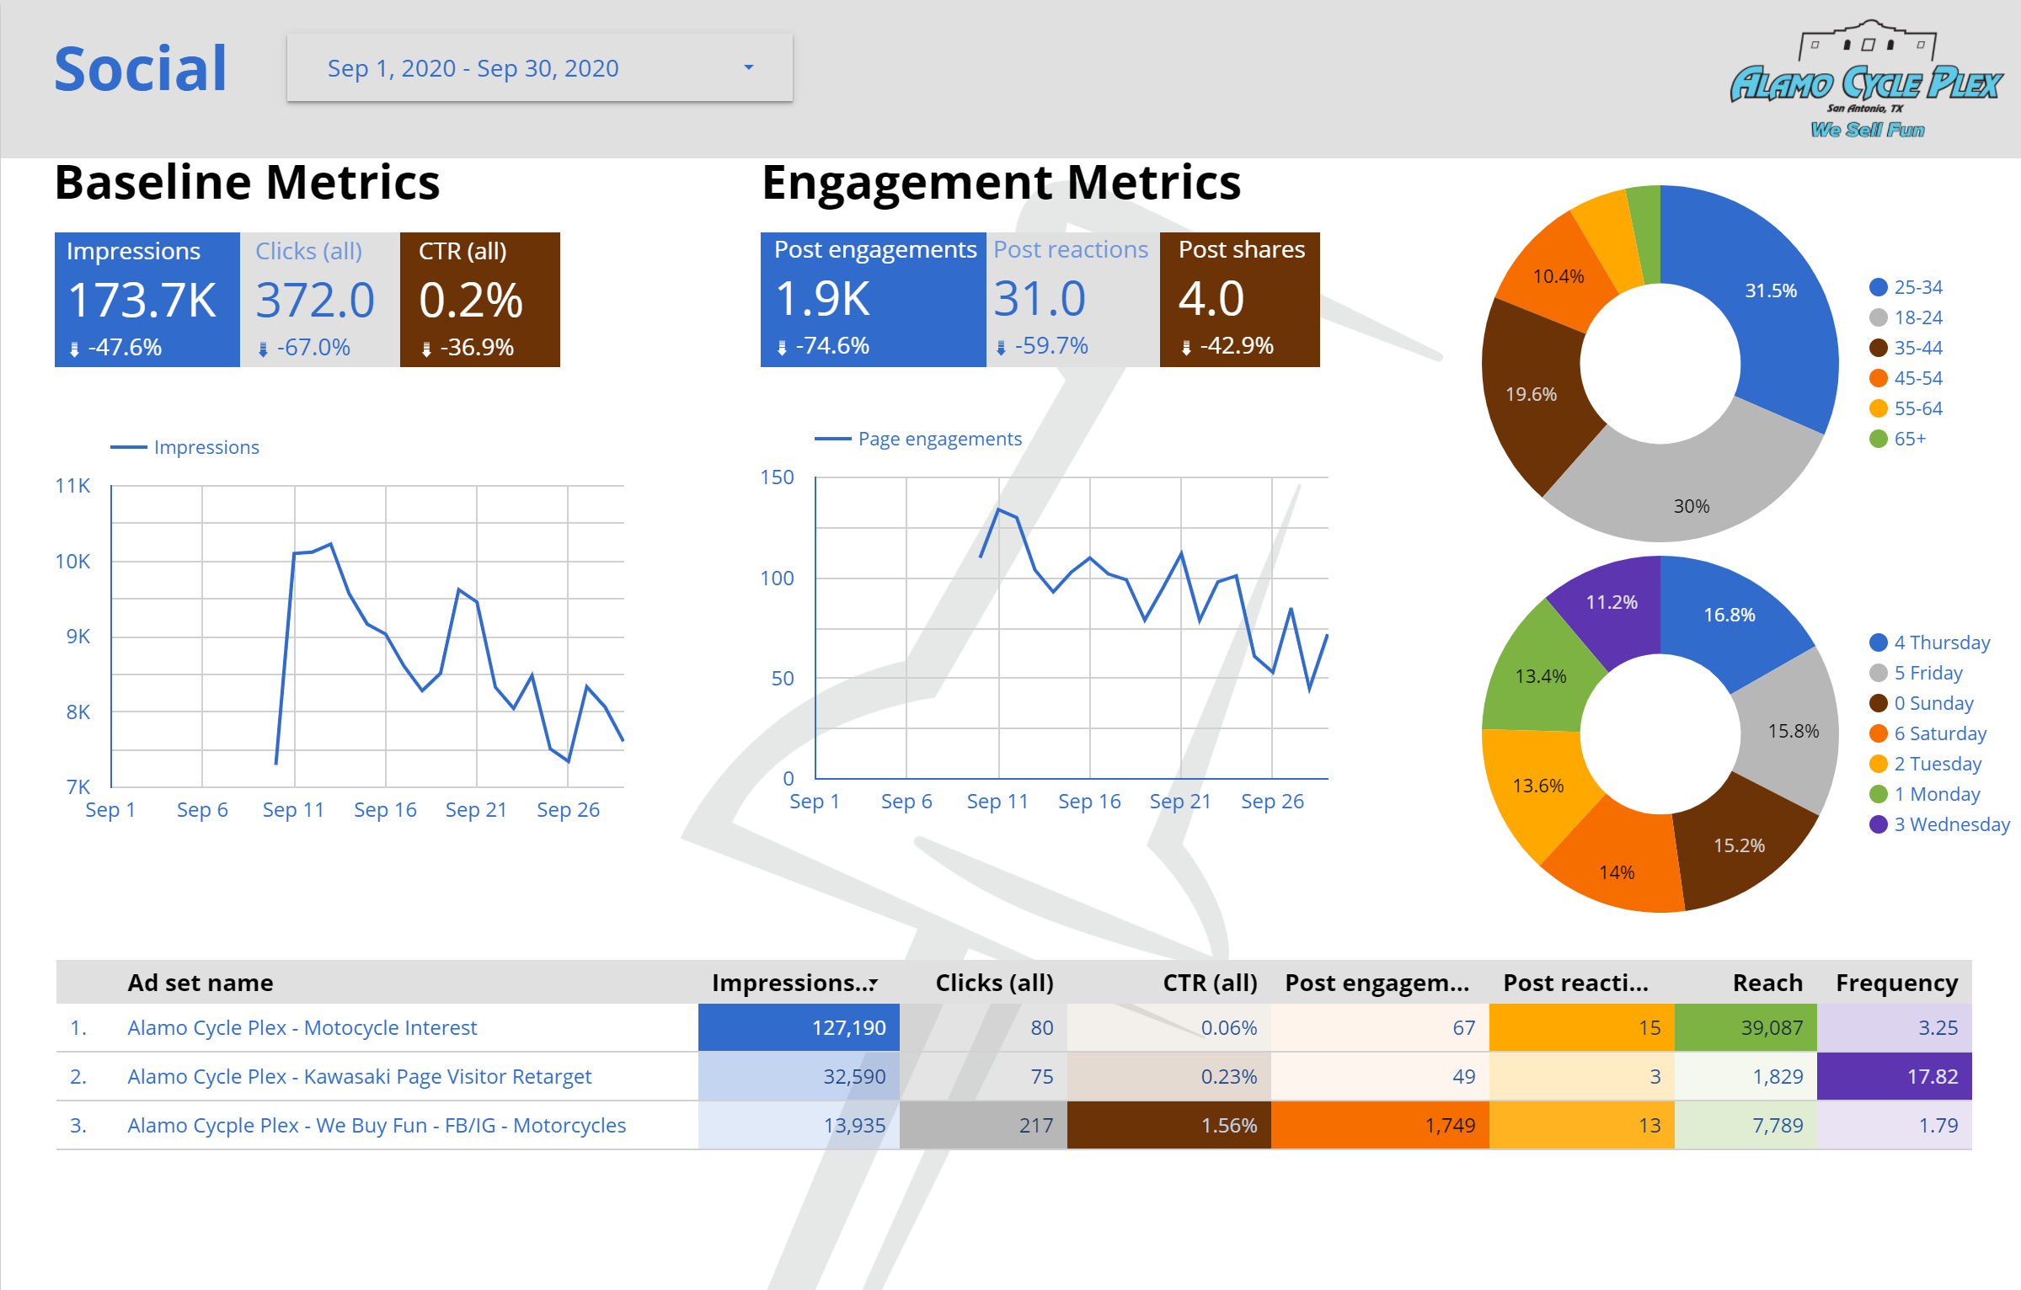
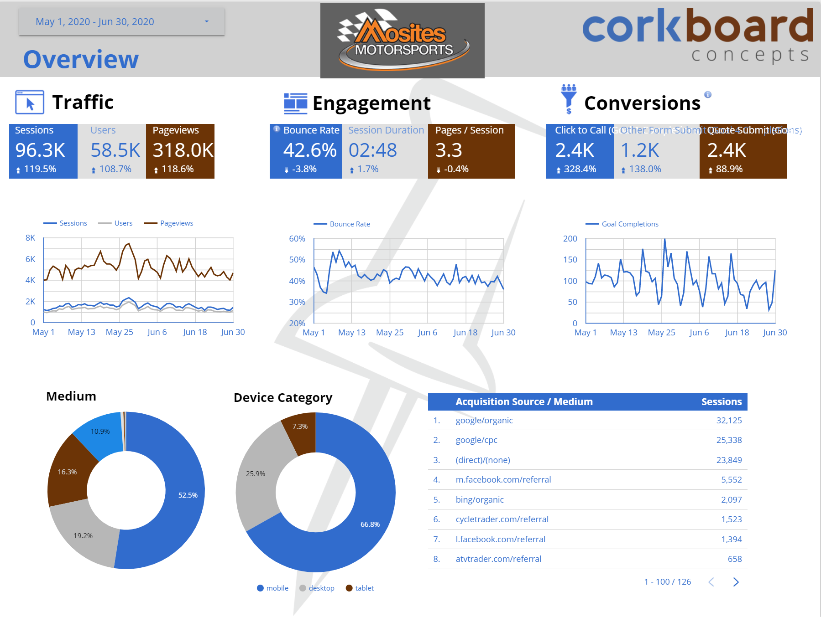
Live Reporting

Slide 13
Next Steps
Audience Building:
For any of those interested, please contact us about setting up your analytics, conversion tracking updates, and more.
Advertising Audits & Feedback:
Each of you should have a brief Digital Audit in the folder’s we’ve provided. This is just a surface report, using external tools. If you would like us to provide a more detailed report, contact Zack or I to gain access to some of your digital properties and we’ll get started!
Selfishly, we’d love to work with you all in some capacity or another but the options above do not require a transaction.

Slide 14
Questions?
Jordan Atchison: Jordan@CorkboardConcepts.com / 724-882-2017
Zack Meuschke: Zack@CorkboardConcepts.com / 412-736-5441
Getting Started: Digital@CorkboardConcepts.com

